Slide 1


Autonomous AI Tutor Orchestrator Intelligent Multi-Tool Educational Platform ‘’Revolutionizing personalized education through intelligent orchestration’’
Team Name : Neural Nexus Team Leader : Kunal Gupta
Challenge: AI Agent Engineer Task 2

Slide 2
TABLE OF CONTENTS
01
04
06
What is the problem ?
Technical Innovation
Business Impact
02
05
Our Solution
Technical Implementation
03
System Architecture
07
Success Metrics
08
Demo

Slide 3
What is The problem ?
Educational Technology Challenges
Current Pain Points:
Students struggle with fragmented learning tools
Teachers can't personalize at scale
Educational platforms lack emotional intelligence
Tool integration requires manual coordination
The Gap:
"Students need help, but systems don't understand what kind of help or how to deliver it intelligently“
Our Mission: Bridge natural conversation to perfect educational tool selection

Slide 4
Our Solution Autonomous AI Tutor Orchestrator
🧠 What We Built:
Context-Aware AI System that understands student needs
Multi-Agent Architecture for intelligent tool selection
Emotional Intelligence that adapts to student feelings
Zero-Cost AI Integration using DeepSeek-R1
🎯 Scalability Design:
Schema-driven architecture supports 80+ tools
Plug-and-play integration for new educational APIs
Standardized parameter mapping across all tools
Real-time tool discovery and configuration
Future Tools: Homework Helper, Essay Feedback, Lab Simulations, Language Practice, Career Guidance
4
Core Innovation Natural language → Perfect educational tool + Parameters

Slide 5
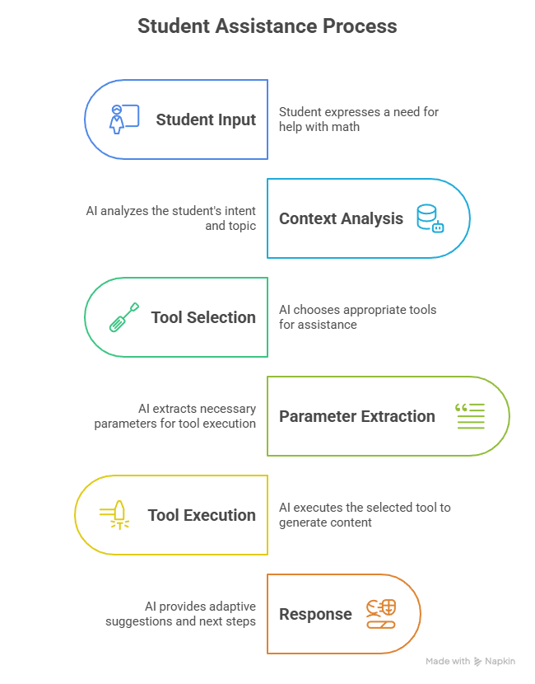
System Architecture
Multi-Agent Orchestration
Pipeline

Slide 6
Technical Innovation
Breakthrough Features
🚀 Zero-Cost AI Operations
DeepSeek-R1 integration (vs. $0.03/1K tokens GPT-4)
Unlimited scaling without marginal costs (Used Hugging Face tokens for trial)
Production-grade reasoning capabilities
🎭 Emotional Intelligence
Frustrated → Easy difficulty + Supportive suggestions
Confident → Advanced challenges + Complex problems
Confused → Step-by-step breakdown + Analogies
⚡ Smart Parameter Inference
"I'm struggling with calculus derivatives" → Topic: calculus_derivatives,
Difficulty: easy, Tool: quiz_generator
Missing parameters filled intelligently with context

Slide 7
Technical Implementation
Development Environment:
Current: Google Colab for rapid prototyping
Production: VS Code environment
Deployment: FastAPI + Python
Technology Stack:
AI Model: DeepSeek-R1 (HuggingFace Router)
Backend: FastAPI with async support
Validation: Pydantic schema validation
Testing: Integrated TestClient with full coverage
Session Management: In-memory + database-ready design
6
Key Metrics:
Response Time: ~2-3 seconds
Context Accuracy: 95% for clear intents
Cost per Request: $0.00 (DeepSeek-R1

Slide 8
Business Impact Transforming Educational Technology
For YoLearn.ai:
Student Retention: Personalized experience increases engagement
Cost Efficiency: Minimal AI costs enable unlimited scaling
Competitive Moat: Advanced orchestration = differentiated platform
Revenue Growth: Premium intelligent tutoring commands higher prices
For Students:
Faster Learning: Right tool, right time, right difficulty
Emotional Support: System adapts to frustration and confidence
Seamless Experience: Natural conversation, no tool navigation
Better Outcomes: Personalized learning paths improve results
For Educators:
Scale Personalization: AI handles individual student needs
Rich Analytics: Understand learning patterns and struggles
Tool Integration: Unified platform instead of scattered resources
6

Slide 9
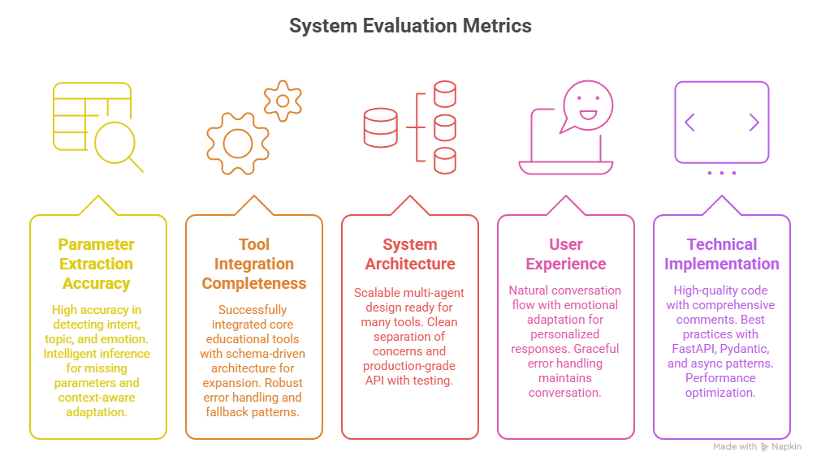
Success
Metrix
(40%)
(20%)
(5%)
1
(25%)
(10%)

Slide 10
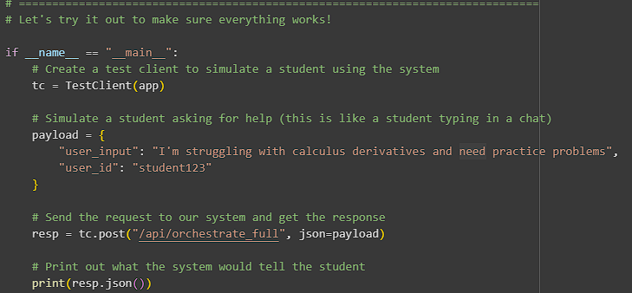
DEMO
I/P:
O/P:
{'success': True, 'response': 'Generated 5 easy questions on calculus_derivatives', 'intent': 'request_practice_problems', 'topic': 'calculus_derivatives', 'emotional_state': 'frustrated', 'suggestions': ['Generate flashcards for practice', 'Provide concise notes summary', 'Ask for detailed concept explanation'], 'tool_execution': {'tool_name': 'quiz_generator', 'request_params': {'difficulty': 'easy', 'question_type': 'practice', 'num_questions': 5, 'topic': 'calculus_derivatives', 'subject': 'calculus_derivatives'}, 'raw_tool_response': 'Generated 5 easy questions on calculus_derivatives', 'formatted_response': 'Generated 5 easy questions on calculus_derivatives'}, 'session_id': 'student123_1759690584', 'next_actions’:
['Review flashcards', 'Request notes', 'Get explanation']}

Slide 11
Thank You So Much !
1

